Slide 1
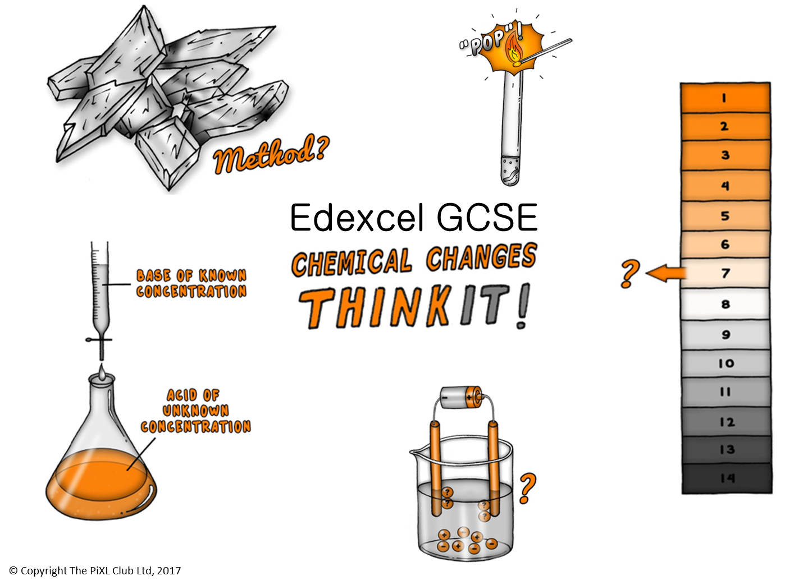

Slide 2
Reactions of Metals with Acids:
Explain why copper sulfate cannot be made by adding copper metal to sulfuric acid.
Explain why potassium chloride should not be made by reacting potassium metal with hydrochloric acid.
(HT only) Explain why the reaction between zinc and hydrochloric acid is a redox reaction.
pH and neutralisation:
Recall the effects of acids and alkalis on the following indicators: litmus, methyl orange and phenolphthalein.
Explain why universal indicator is a poor indicator for use in titrations.
Explain why there is a difference in pH between hydrochloric acid and ethanoic acid of the same concentration.
How does water affect the properties of ethanoic acid?
Practical:
Explain why, if soluble salts are prepared from an acid and an insoluble reactant: excess of the reactant is added; the excess reactant is removed; the solution remaining is only salt and water.
Explain why, if soluble salts are prepared from an acid and a soluble reactant: titration must be used; the acid and the soluble reactant are then mixed in the correct proportions.
Titrations:
Describe how to accurately calculate the reacting volumes of strong hydrochloric acid and strong sodium hydroxide solution.
Explain how to calculate the concentration of sodium hydroxide solution needed if 27.5 cm³ of 0.2 mol/dm³ hydrochloric acid is required to titrate 25.0 cm³ of sodium hydroxide solution.
:
Electrolysis:
Explain the differences between the electrolysis of molten sodium chloride and the electrolysis of sodium chloride solution.
To carry out the electrolysis of water, sulfuric acid is added. How does the addition of sulfuric acid produce a conducting solution?
(HT only) Describe the electrolysis of lithium fluoride solution using half equations.
Edexcel GCSE Chemical changes
ThinkIT!
© Copyright The PiXL Club Ltd, 2017
Salts:
How could scientists identify an unknown chemical as being a carbonate?
Explain a method to show how lithium chloride can be synthesised in the laboratory.
A sample of copper sulphate crystals was accidently contaminated with sand. Describe the method to regain the pure copper sulphate crystal back again.
:
Identification of common gases:
A lit splint is put into a test tube of an unknown gas, the splint goes out. Describe how you could prove that the gas is carbon dioxide.
Which two gases cannot be in the test tube? Explain your answer.
Electrolysis:
Explain why ionic substances only conduct electricity when molten or in an aqueous solution.
Suggest why aluminium knives and forks used to be more precious than gold in the 19th century.
(HT only) Explain using half equations which ions are oxidised and which ions are reduced in the electrolysis of aluminium oxide.

